Slide 1
Canadian Cubesat Project (CCP) Mission Concept Review
Communications Subsystem
Presented By:
Nicholas Hansen
Dalhousie Space Systems Lab. (DSS)

Slide 2
Subsystem Overview
Relay data to and from the satellite
Achieve reliability through a low bit error rate
Achieve throughput through high bitrate
Overcome factors which limit or destroy ability to communicate

Slide 3
Team Members
Role | Name
Team Lead | Nicholas Hansen
GNU Software Specialist | Alex Amellal
Ground station pointing and tracking | Brandon Johnson
Antenna Prototype and test | Eptehal Nashnoush & Yutong Wang
Systems Engineering | Mboza Lukindo

Slide 4
Presentation Outline
Design Rationale
Design constraints
System Design Proposal

Slide 5
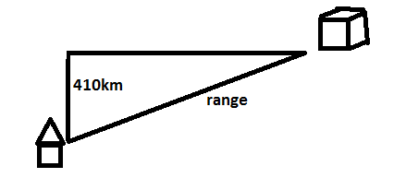
Design Rationale
First we considered the orbital motion
Basing analysis on the ISS, since the anticipated orbit is similar
Using AGI STK simulation we obtained some estimates and made some observations
For a single ground station
Access based solely on range
With more range we can make use
of more satellite passes overhead

Slide 6
Not favourable.
Favourable

Slide 7
Spectrum Planning
Next we considered the use of radio spectrum
ITU and ISED regulate use of radio spectrum
Associated costs are prohibitive, except for Amateurs
Many Cubesat missions already utilize amateur frequency allocations in VHF, UHF

Slide 8
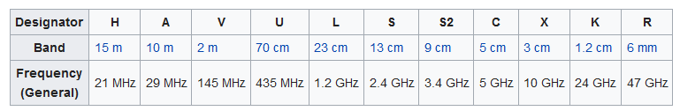
Amateur Bands

Slide 9
S2 band benefits
Small size of antenna and transceiver
Lots of Bandwidth available for both uplink and downlink
No ISM band interference (unlike 13cm band)
Free space loss and atmospheric absorption losses are low
COTS equipment is available

Slide 10
Design Constraints
Cost
Size
Power consumption
Using physics we can produce an estimate of how much power / BW we need. (Link Budget)

Slide 11
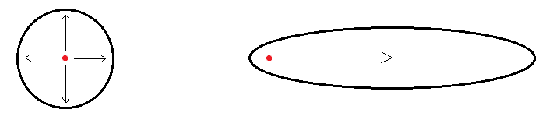
Contributing Factors
Energy emitted from the antenna
Directivity of the antenna (Gain)
E.g. 1 Watt exiting the antenna
No Gain
High Gain

Slide 12
Detracting Factors
Free space loss (spreading loss)
System inefficiency losses (Line, amplifier, antenna)
Noise
Internal to the System (Thermal, constant)
External (AWGN, random)
Pointing loss, in the case of high gain
Others…?

Slide 13
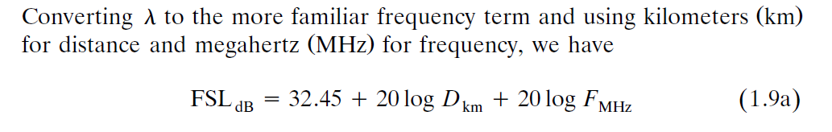

Link Budget
Done in MATLAB based on equations from “Radio System Design for Telecommunications” By Roger L. Freeman

Slide 14
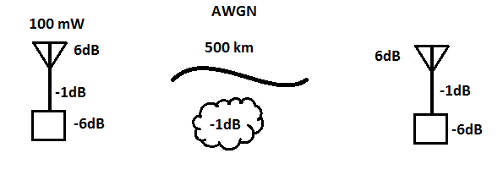
Link Budget
Energy Contributions – Energy losses… anything left to detect?
Range 500 km
6 dB gain antenna
6 dB noise figure receiver
AWGN channel
Nominal line loss, gaseous loss
100 mW of power exiting the antenna
For 38 kbps… Eb/N0 = 23 dB, a ratio of 200
CNR_{dB}= 15.8dB … yes, detectable.

Slide 15
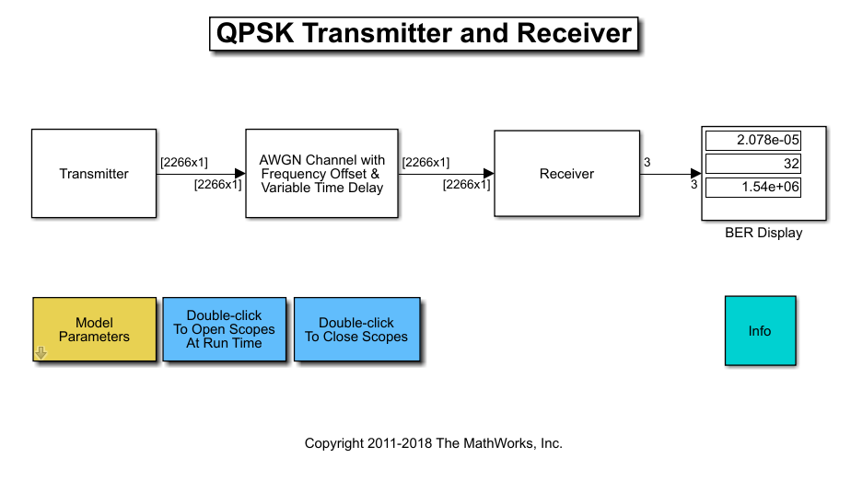
Simulation
Simulink is a powerful tool to estimate system performance and for comparison
A generic system with Eb/N0 = 23 dB will suffer approximately 2e-5 BER… 2 bits out of 10000

Slide 16
System Design Proposal
Searching for COTS:
Based on parametric search for single stage RF front ends that can operate at 3.4 GHz there are several options on the market.
Analog Devices AD936x, AD937x, ADRV900x
Maxim Integrated MAX282x
TI AFE768x
However these products still require a PCB and aren’t really ‘solutions’.

Slide 17
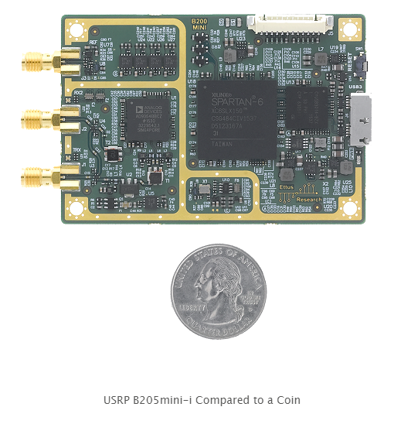
Transceiver Candidate
Ettus Research: USRP B200 mini-i
1,115$ CAD without enclosure
SDR based on AD9364 RF frontend
Tunable to 70MHz-6Ghz
83.3 x 50.8 x 8.4 mm (fits)
Programmable FPGA

Slide 18
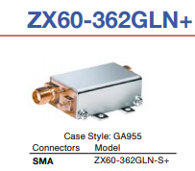
Transceiver Candidates
8dB noise figure
10-20dBm tX power
Will need additional amplifier
Very flexible
‘industrial grade’ FPGA available
2 week lead time

Slide 19
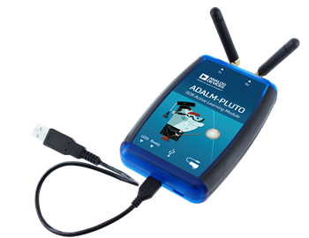
Transceiver Candidate (Ground)
Analog Devices: ADALM-PLUTO
141.58$ CAD on Digikey
Based on AD9363 RF frontend
Fully open source
Tunable 325 – 3.8 GHz
Slightly too long to fit in bus

Slide 20

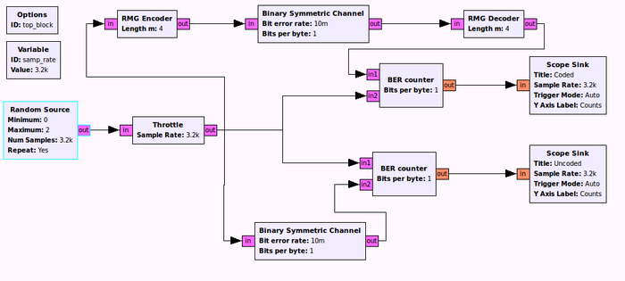
Software:

Slide 21
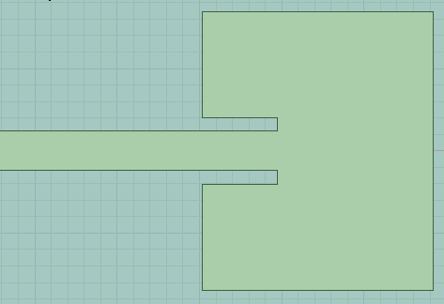
Antenna Candidate
Patch antenna designed in HFSS
RT/duroid® 5870 Laminates
Extreme durability
Low outgassing
Simulated Characteristics:
VSWR: 0.025 – 1 dB
Gain: 7 dB
HPBW: 50 degrees
Impedance Matched for 50 Ohms
Manufacture by precision milling

Slide 22
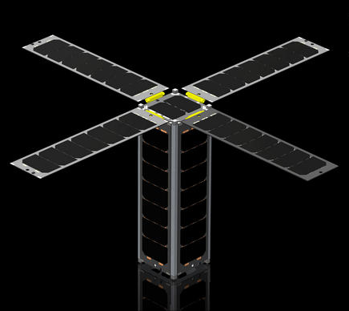
Patch antenna array
Deployable wings are planned
On the bottom we can achieve a very high aperture
CP can be achieved more easily
A work in progress…

Slide 23
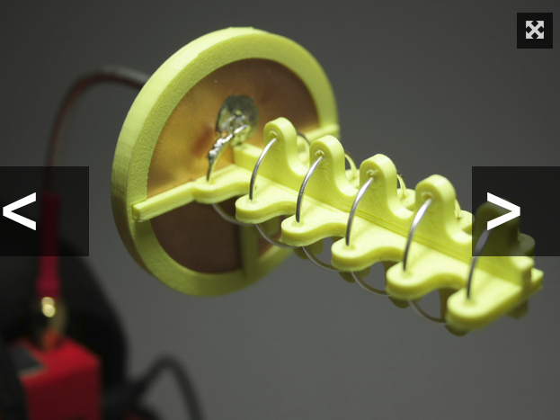
Antenna Candidate (Ground)
Monofilar Helical antenna
Customizable
Can be configured in an array
Calculated Characteristics:
Gain: 13 dB
HPBW: 39 degrees
RHCP
Manufacture by 3D printer

Slide 24
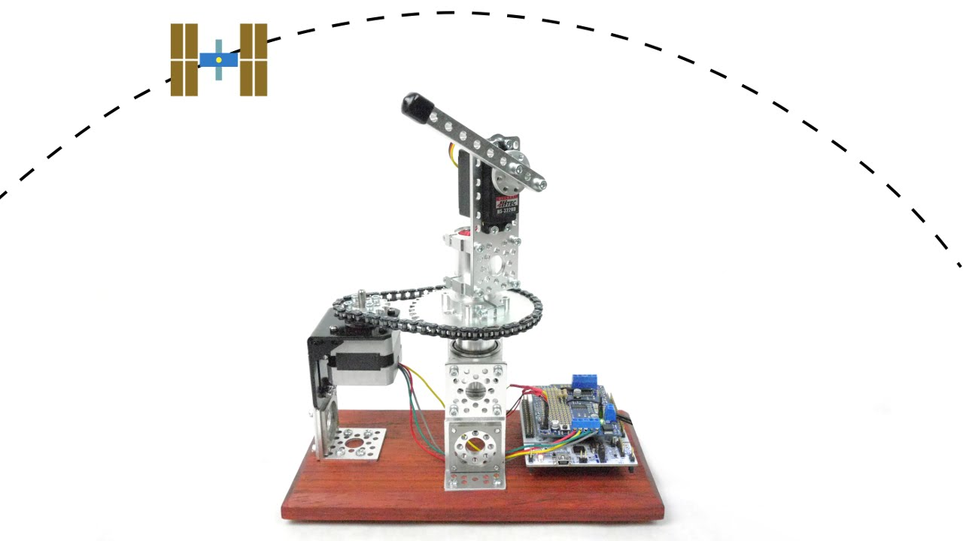
Tracking and Pointing System

